Slide 1

Data Visualization stream – DV09
Oversight and Insight within a Fast-Moving Biotech Company
Stijn Rogiers,
Head Data Integration & Standards Team - Data Management (DM), argenx
Phil Mason,
Stats Programmer - Quantitative Sciences (QS), argenx
8 Nov 2023

Slide 2
Oversight and Insight within a Fast-Moving Biotech Company
COMPANY OVERVIEW
TRIAL OVERSIGHT
INSIGHT GENERATION
KEY LEARNINGS

Slide 3

Company
Overview

Slide 4


We are on a bold mission
Transforming the lives of patients with severe autoimmune disease through immunology innovation

Slide 5
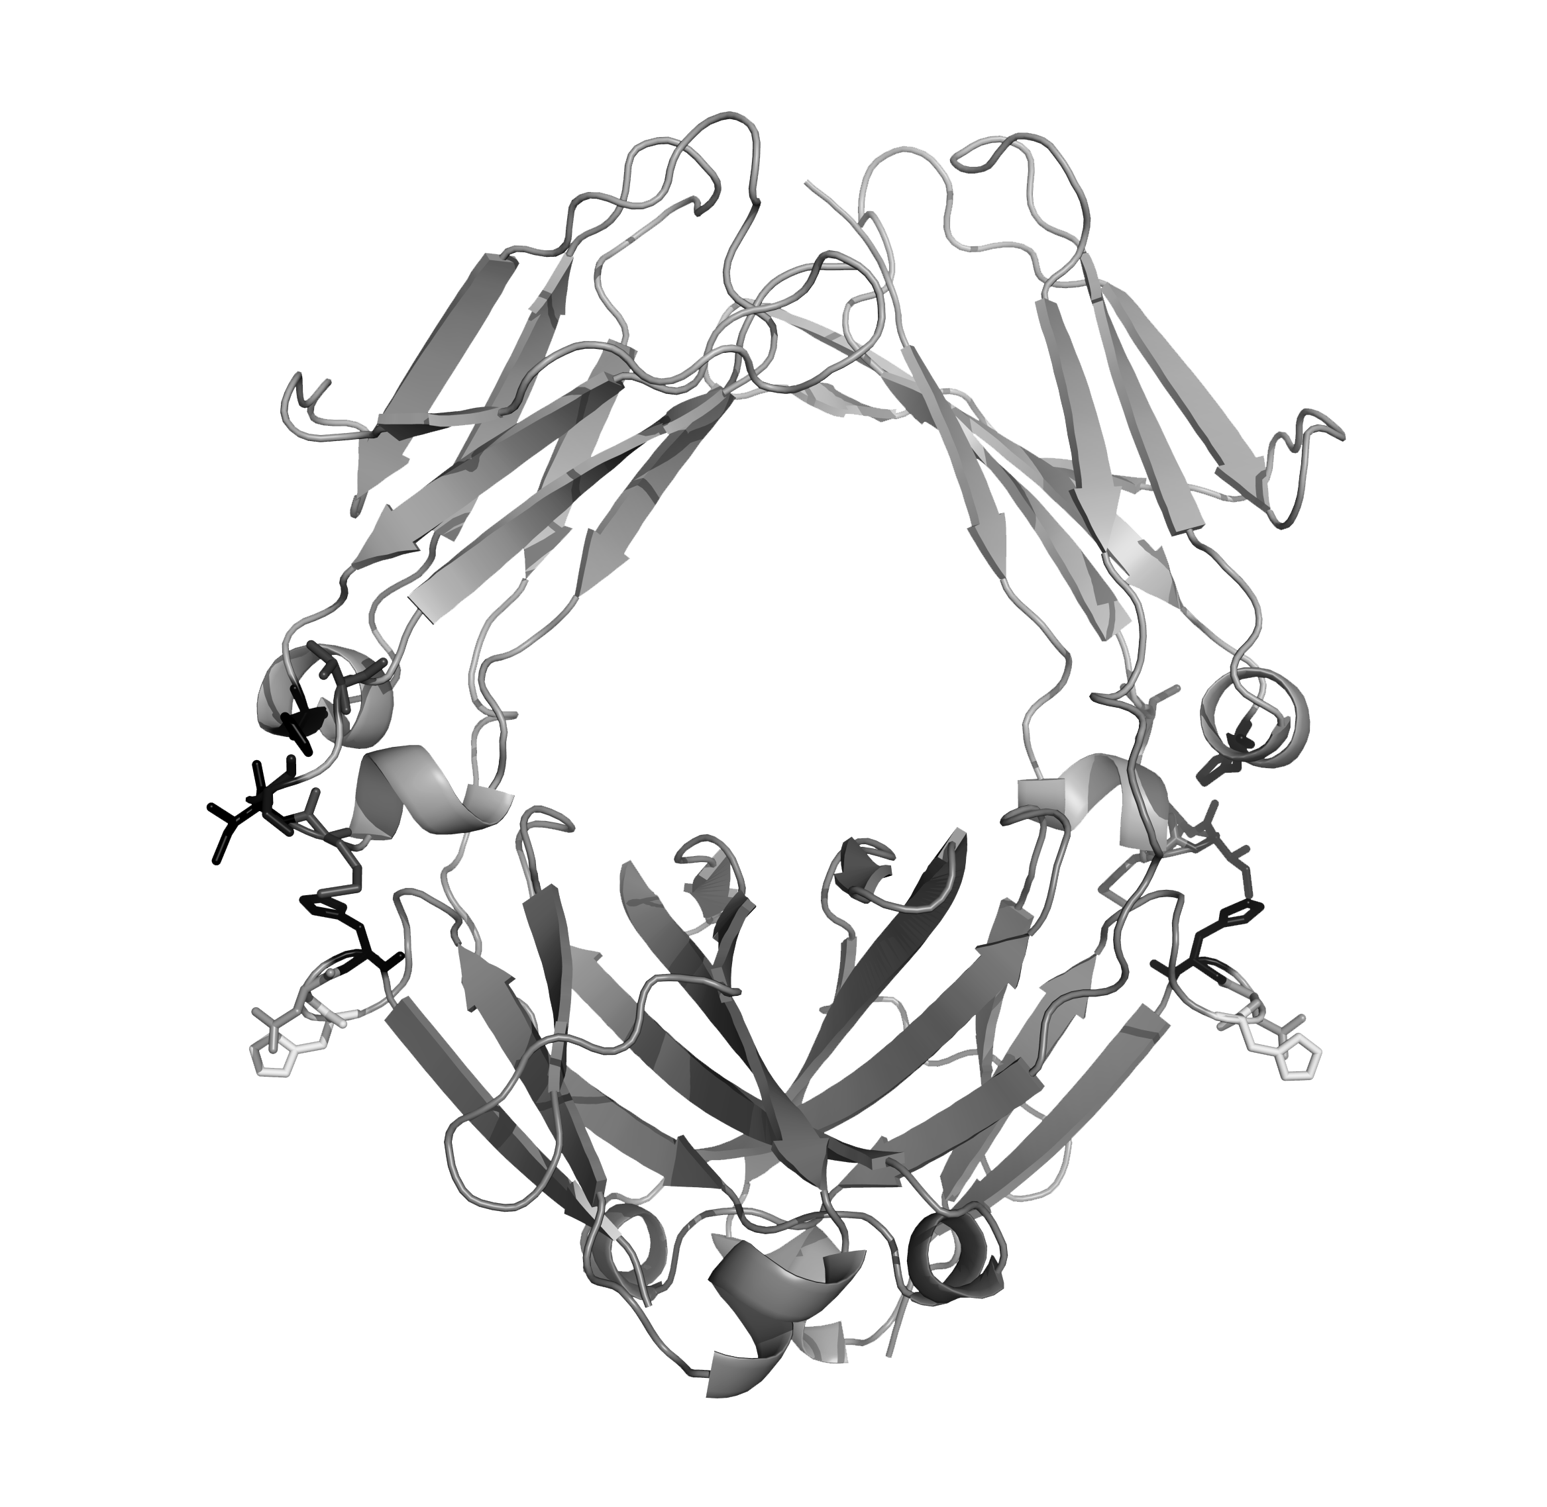


Redefining Autoimmune Diseases With Precision Medicine Approach
A pipeline of precision tools
Redefine our pipeline of autoimmune diseases as IgG-mediated or complement-driven
Offer new targeted treatment modality in diseases where innovation is most needed
Autoimmunity is Prime for REVOLUTION

Slide 6
































Innovation Ecosystem
discovery
Build out innovation ecosystem

Slide 7
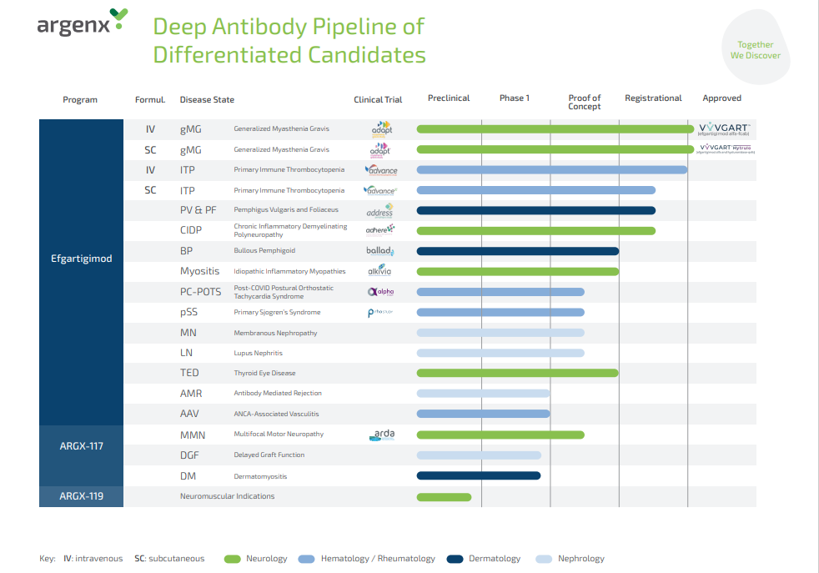

Slide 8

OVERSIGHT
Data Visualization and Tracking of findings for improved Trial Oversight

Slide 9
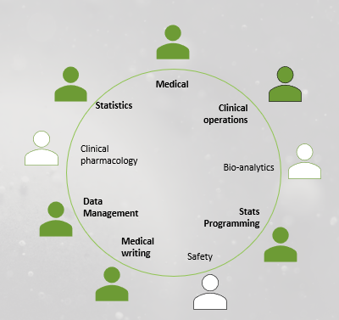
2019 – 2021: Establishing a strong foundation for efficiency, scalability and de-risking staff dependency within Clinical Development
Structured
Data Repository
&
Statistical Computing
Environment
Establishment
Cross Functional
Standards Governance
Team
Clinical
Metadata
Repository
Partner Eco System:
SAS Institute & OCS Consulting
Solution:
SAS Life Science Analytics Framework (SAS LSAF)
Partner Eco System:
Formedix
Solution:
Ryze

Slide 10

Near Real Time Data Flow
(2022-2023)
AS IS
MONTHLY SDTM delivery by DM-CRO partners
Trial Oversight by argenx DM
Generic ADaM and Patient Profiles by argenx QS
Medical Review using DM-CRO listings, Patient profiles and Data Visualizations
TO BE
+ WEEKLY (or DAILY if required) Generic SDTM creation by argenx DM
facilitates...
Improved Trial Oversight by argenx DM
Weekly Generic ADaM and Patient Profiles by argenx QS
Medical Review on near-real time data (weekly instead of monthly)
Supports also Improved Trial Oversight for argenx Sample Managers

Slide 11
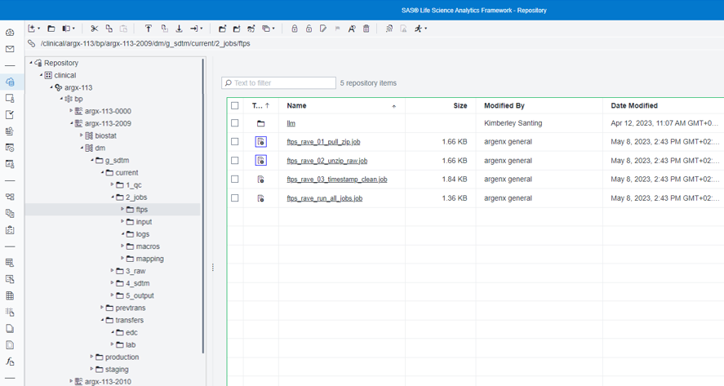
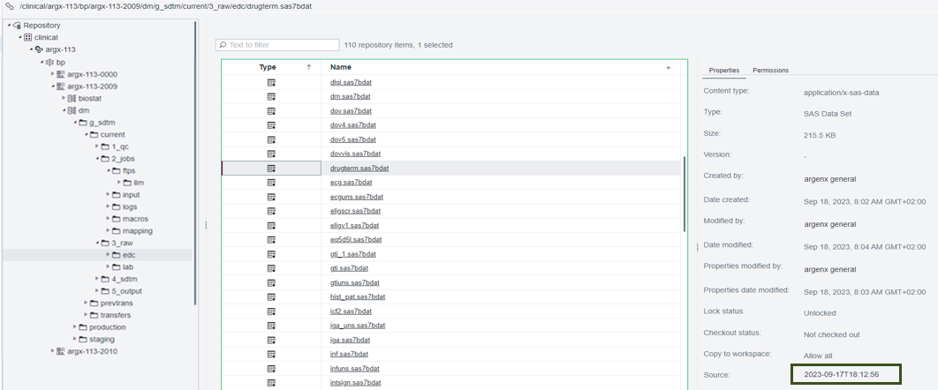
Near Real Time Data Flow
(2022-2023)
PHASE I of the project
EDC Raw Data Pull
From Medidata Rave into SAS LSAF
for multiple DM-CRO partners
(weekly/daily)
… working also on pulling in external data starting with central labs.

Slide 12


Near Real Time Data Flow
(2022-2023)
Mapping Engine for gSDTM within SAS LSAF
Selection partner / solution (Q4 2022)
Development MVP (Q1 2023)
Including 5 pilot trials
priority domains DM, EC/EX, DS, AE, CM, T-DOMAINS
Scaling to other domains and ALL ongoing & new argenx trials
PHASE II of the project
Creation of generic SDTM [ gSDTM ]
(weekly/daily)

Slide 13
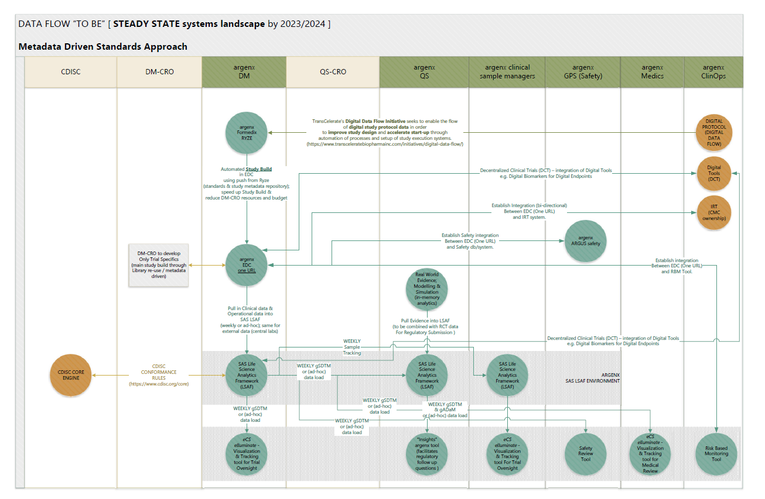

Slide 14
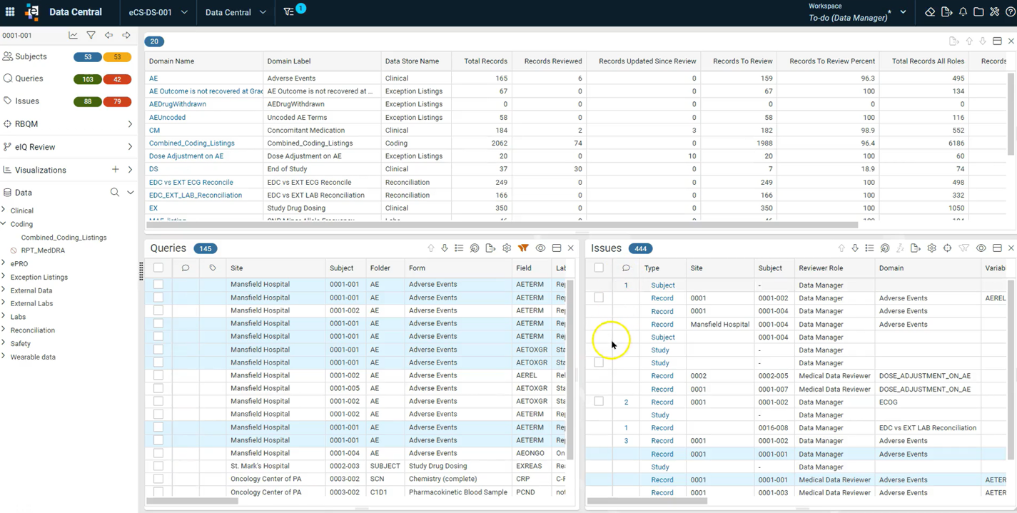

2023 – 2024: Data Visualization & Tracking of findings for improved Trial Oversight

Slide 15
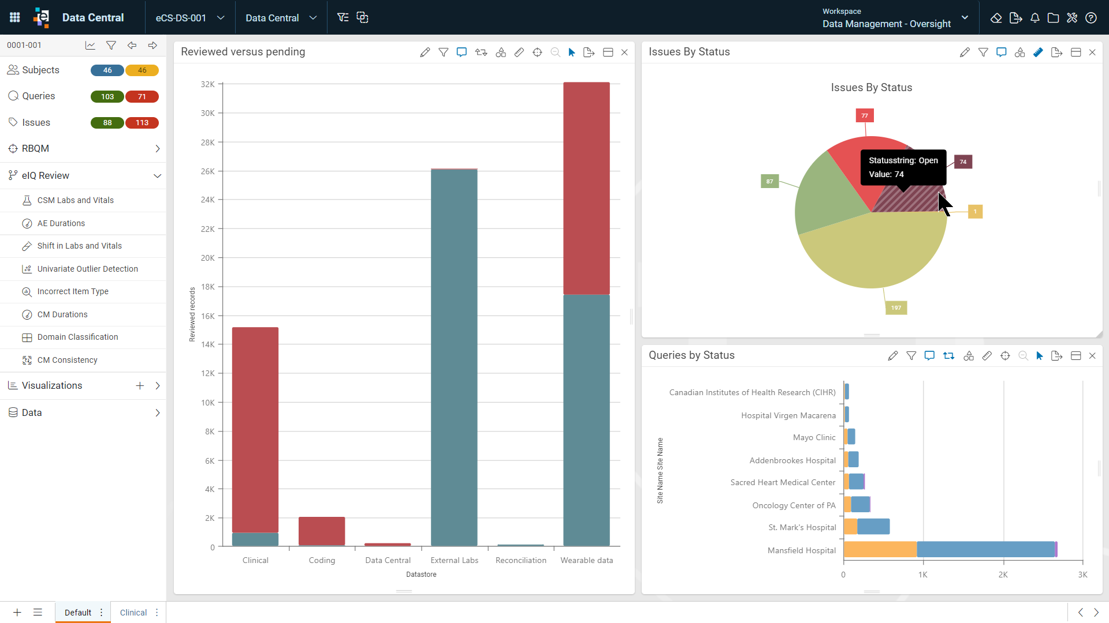
2023 – 2024: Data Visualization & Tracking of findings for improved Trial Oversight

Slide 16
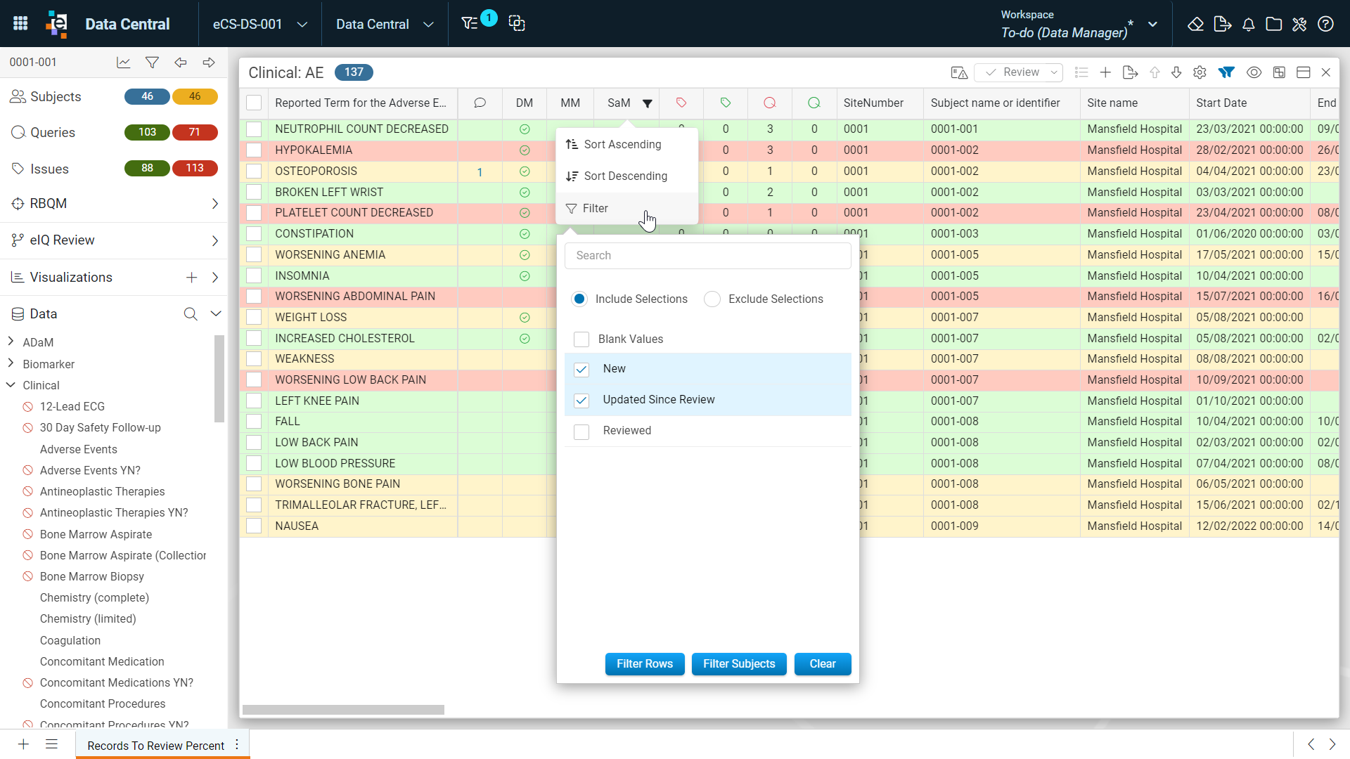
Review Tracking & Collaboration

Slide 17
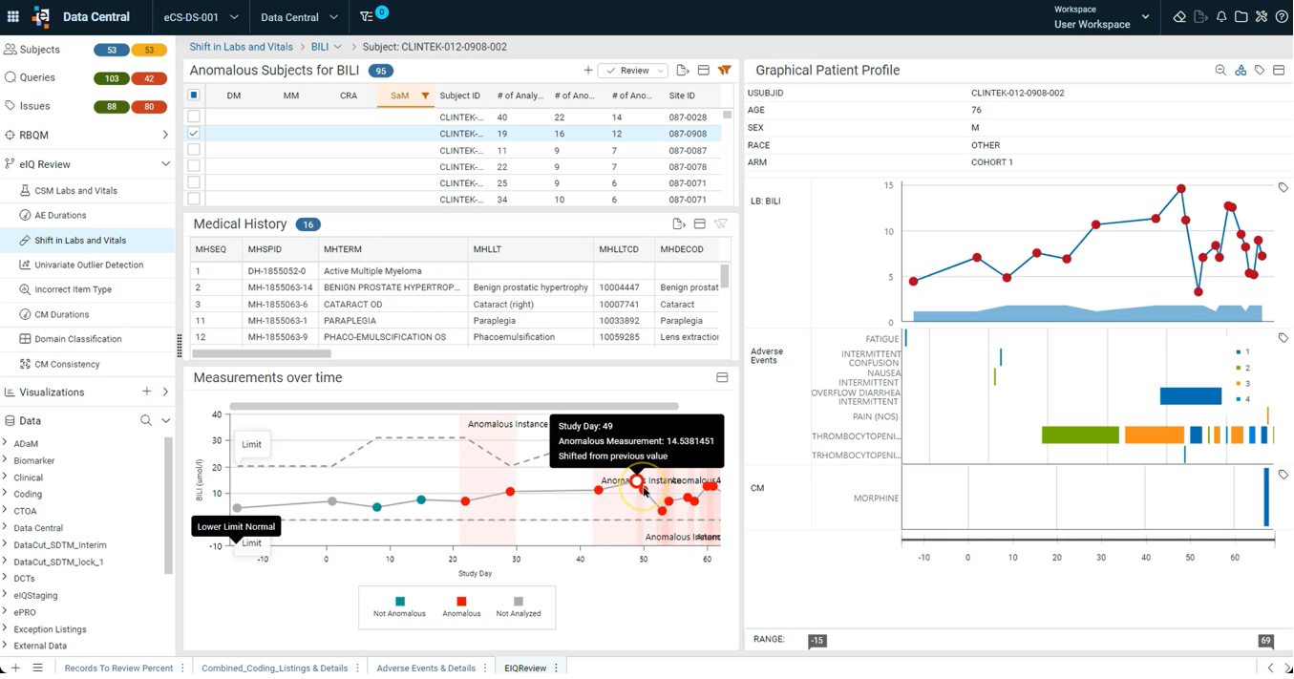
Anomaly
Detection &
Patient Profile

Slide 18
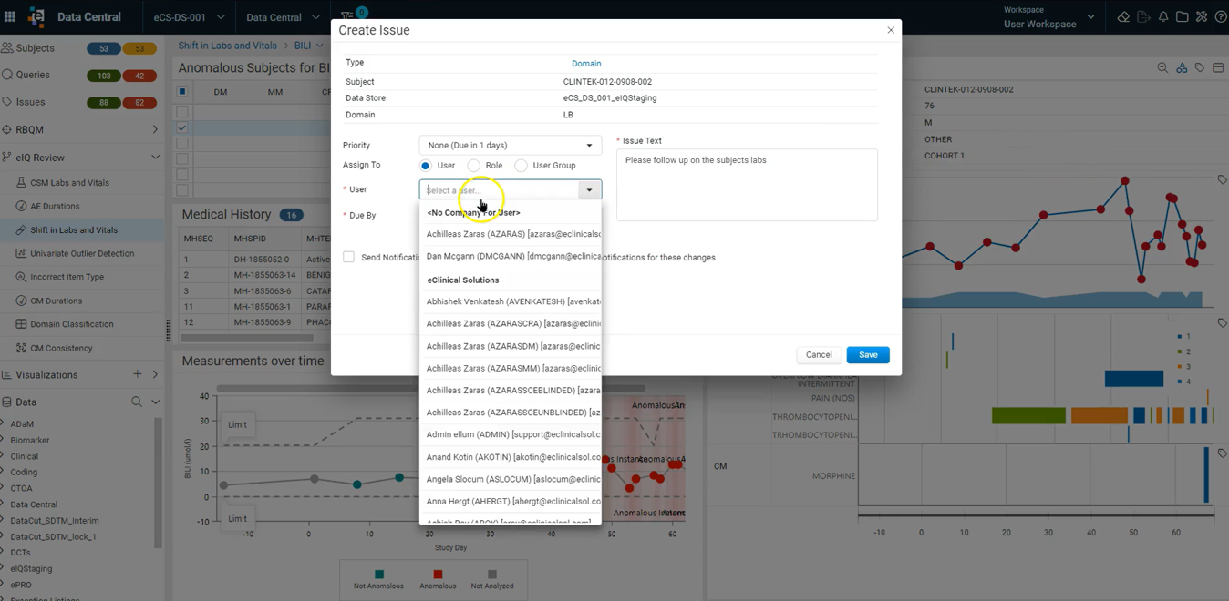
Follow up & traceability

Slide 19
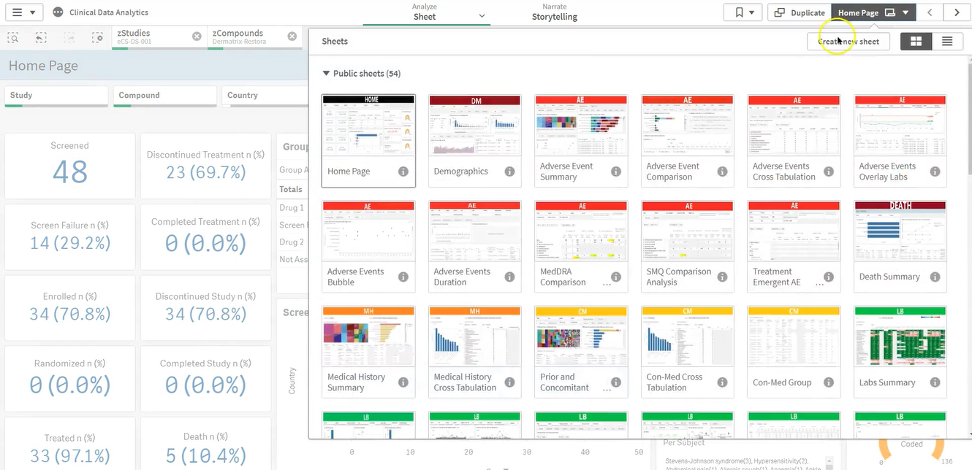
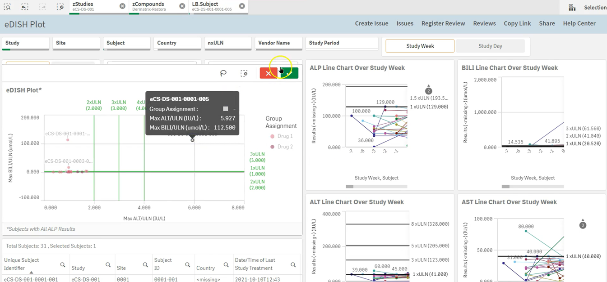
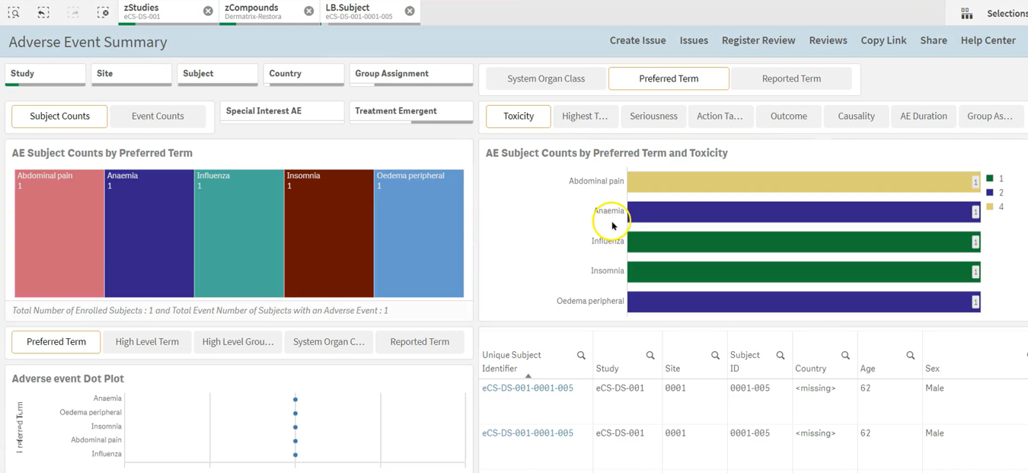
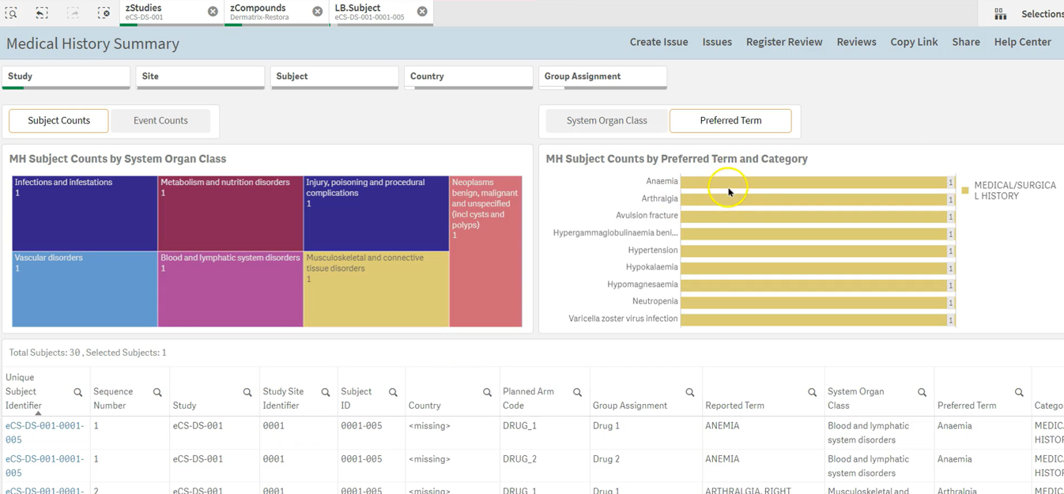
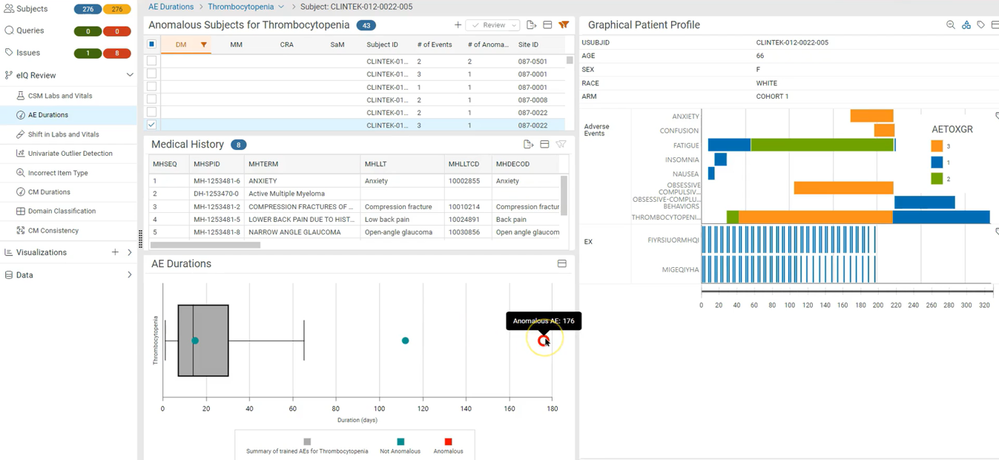
‘Out of the box’
Cross Study Interactive
Visualizations

Slide 20

INSIGHT GENERATION
Providing answers to internal and external questions
Notes:
Provides platform for biostatisticians (& others) to investigate questions which often arise from Regulatory authorities.
Doesnt replace validated statistical reporting
Official outputs follow our SOP's and WI's

Slide 21
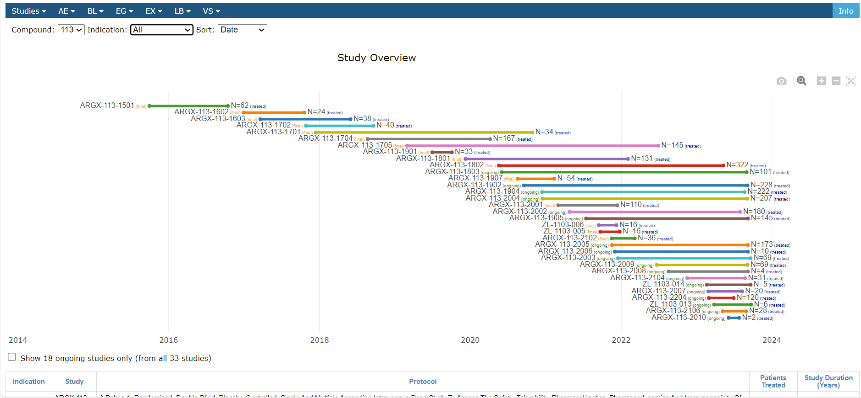
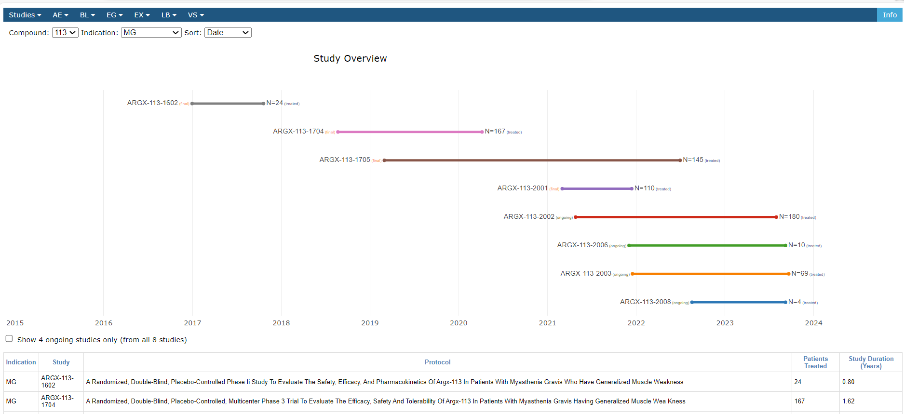
Insight Generation (argenx tool) – Study Overview
Notes:
Insight web app hosted on SharePoint based off JSON files, which are produced in LSAF.
All figures produced in LSAF by SAS (or R) processes.
Shows when studies ran, when patient data started/stopped (FPFV, LPLV, LP last contact).
Toggle showing ongoing studies
Filter at top by compound, indication & sort. Can zoom in/out
Choose an indication to filter – MG
Various pages available for SDTM domains
Choose AE – Summary from the menu bar (see next screen)

Slide 22
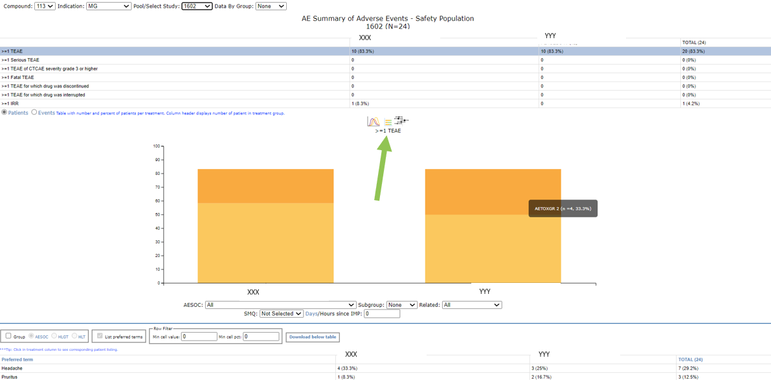
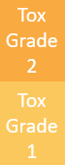
Adverse Events Summary
Notes:
Select a study and click line in table to see graph for that (go through options, e.g. TEAE, serious TEAE, etc.)
Toggle between showing patients or events.
Click on graph to show AE details in a popup window, from which you can open Patient narratives (word file)
Filters for SOC, subgroup graph
Explore via icons
baseline characteristics (DEmography stats like age, gender, etc.)
forest plots (compare risk of AEs)
patient profile wall (indicated by arrow) takes us to next slide

Slide 23
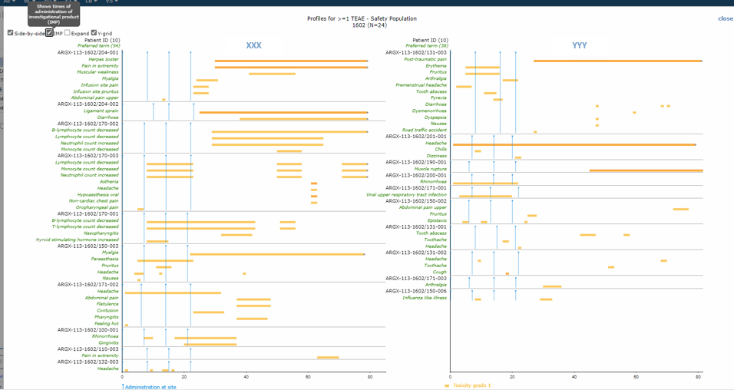
Patient Profile Wall
Notes:
See when TEAEs happened for patients for each treatment
Color is the tox grade
with patients having the worst AEs at the top.
Can show when treatment given (IMP)
Expand to show all AEs – not just TEAEs
Y-grid puts line between each patient
Hover over bar gives details of AE – tox grade, from, to, outcome, related, days since treatment
Close this wall to return to AE screen

Slide 24
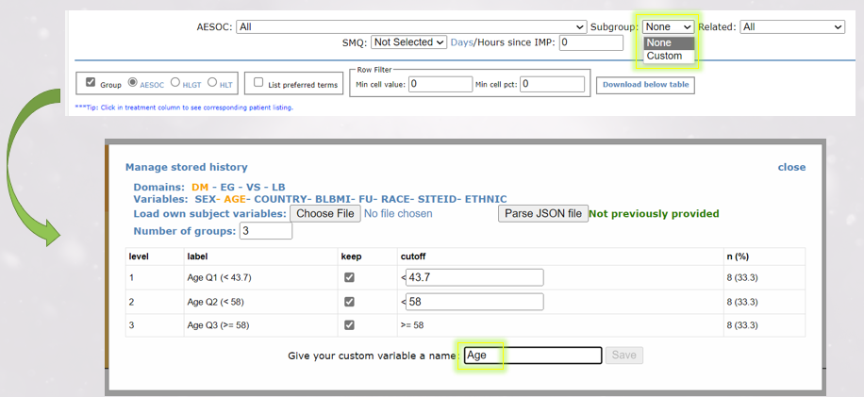
Subgrouping
Notes:
Going back to AE summary can filter (under graph)
by SOC
SMQ (standardized MedDRA Queries
Related status
AE to occur within a number of days or hours since dosing (can choose)
Subgroup – Custom – shows screen where we can subgroup by value ranges defined, e.g. 3 age ranges.
Customisable but makes sensible defaults
Keep can be selected to choose what subgroups to show on graph
Get useful stats shown for subgroups we plan to make
Lets us explore AE data and compare different groups/segments to look for answers to queries.
press save to close popup and return to show effect

Slide 25
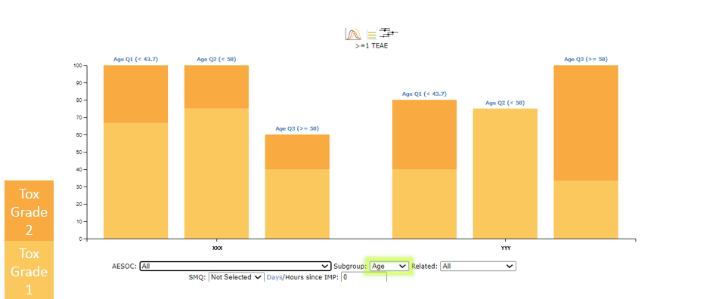
AE Graph (by subgroups)
Notes:
Now we have a bar for each subgroup uses label over bar
Aids investigation / answering questions / understanding relationships
Click on part of graph to show AEs with link to patient narratives
Make another subgroup using custom
It remembers ones you make till you remove them from history

Slide 26
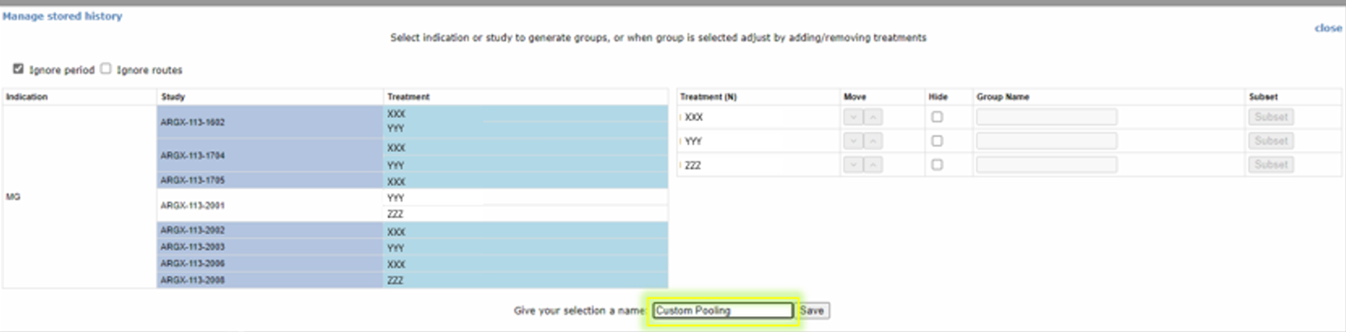
Pooling studies in Real Time
Notes:
Choose custom as the study to make a pool from studies
Select studies you want
Save under a new name
See result on next screen

Slide 27
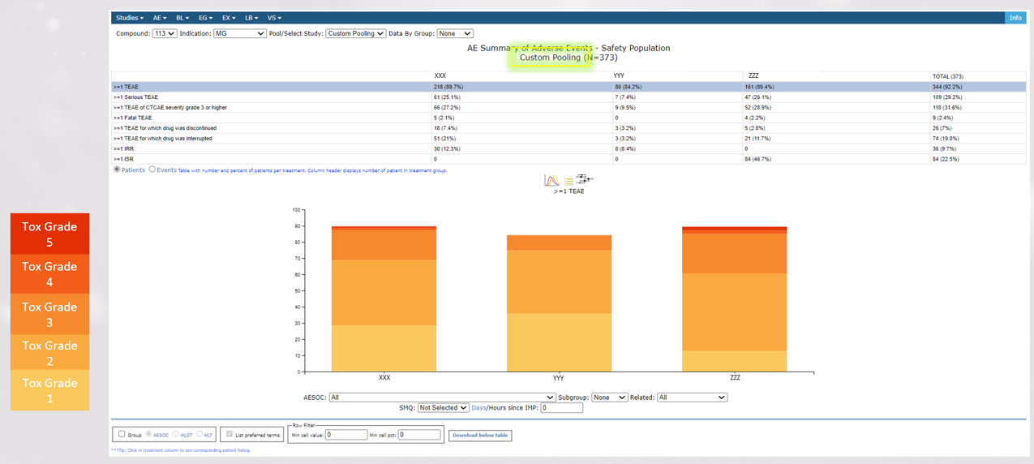
Custom Pooled Study Graphs
Notes:
Results for the pooled data is shown (see N has increased a lot)
Can use in meetings/brainstorms – drives insight
If biostats find answers to questions, they can lead provide info to a programmer to produce a ‘proper’ program (following SOP's and WI's) and QC which should match (as this is all based on QCed gADAM data)

Slide 28
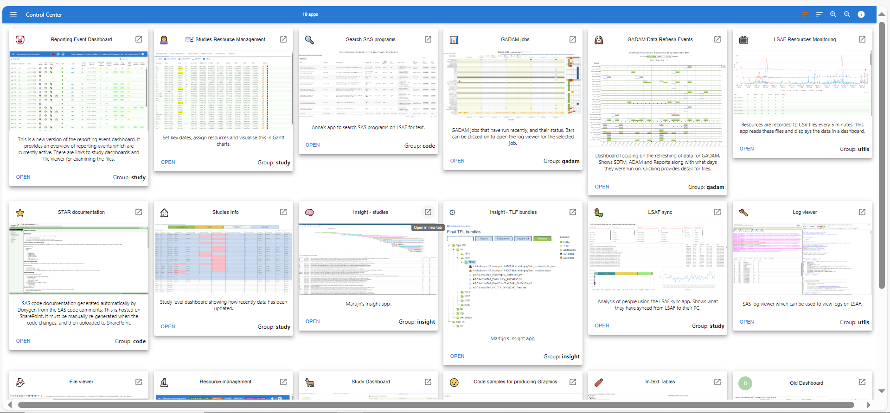
... and there is more

Slide 29

KEY LEARNINGS
Critical Success Factors &
Challenges Ahead

Slide 30
CRITICAL SUCCESS FACTORS
ENTREPRENEURIAL SPIRIT
REQUIREMENTS > BUDGET APPROVAL > VENDOR SELECTION > IMPLEMENTATION (e.g. LSAF, RYZE, ...)
GO-LIVE WITHIN 3-6 MONTHS
EMPOWERMENT & EXCELLENCE
EMPLOYEES EMPOWERED TO TAKE DECISIONS
DATA DRIVEN DECISION MAKING
QUALITY BY DESIGN (no legacy)
CO-CREATION
CROSS-FUNCTIONAL TEAMS (ARGONAUTS) WORKING AS ONE TEAM WITH SAME OBJECTIVES
EXTERNAL COLLABORATIONS WITH LEADING TRANSLATIONAL BIOLOGY LABS; TECH VENDORS & CRO PARTNERS
’NOT INVENTED-HERE SYNDROME’ - NOT APPLICABLE

Slide 31
CHALLENGES AHEAD
KEEP ARGENX “DNA” WHILE BECOMING MID-SIZED BIO-TECH COMPANY
KEEP RECRUITING TOP TALENTS (WITH SAME DNA)
INCREASE LEVEL OF STANDARDIZATION (FROM PROTOCOL DESIGN TO SUBMISSION ... AND BEYOND)
PIPELINE (VOLUME OF TRIALS)

